Slide 1
Data Analysis –Project I
Hotel Booking Cancellations

Slide 2

Business Problem
In recent years City Hotel and Resort Hotel have seen high cancelation rates. Each hotel is now dealing with a number of issues as a result, including fewer revenues and less than ideal hotel room use. Consequently, lowering cancellation rates is both hotels’ primary goal in order to increase their efficiency in generating revenues , and for us to offer thorough business advice to address this problem.
The analysis of hotel booking cancellations as well as other factors that have no bearing on their business and yearly revenue generation are the main topics of the report.

Slide 3
Assumptions
No Usual occurrences between 2015 and 2017 will have a substantial impact on the data used.
The information is still current and can be used to analyze hotel’s possible plan in an efficient manner.
There are no anticipated negatives to the hotel employing any advised technique.
The hotels are not currently using any of the suggested solutions.
The biggest factor effecting the effectiveness of earning income is booking cancellations.
Cancellation results in vacant room for the booked length of time.
Client make hotel reservations the same year they make cancellations.

Slide 4
Research Questions
What are the variables that affect hotel reservation cancellation?
How can we make hotel reservations cancellations better?
How will hotels be assisted in making pricing and promotional decisions.
Hypothesis
More cancellations occur when prices are high.
When there is a longer waiting list, customers tend to cancel more frequently.
The majority of clients are coming from offline travel agents to make their reservations.

Slide 5
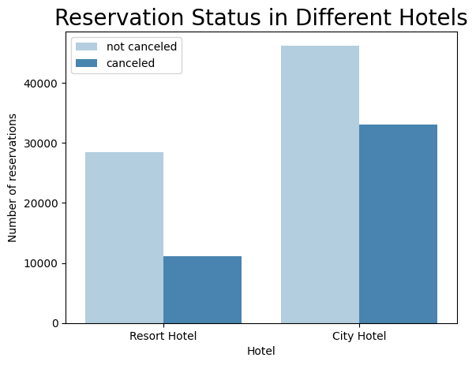
Analysis and Visualizations
The accompanying bar graph shows the percentage of reservations that are cancelled and those that are not. It is obvious that there are still a significant number of reservations that have not been cancelled . There are 37 % clients who cancelled their reservations which has a significant impact on hotel’s earnings.
In comparison to resort hotels, city hotels have more bookings. It’s possible that resort hotels are more expensive than the city hotels.

Slide 6
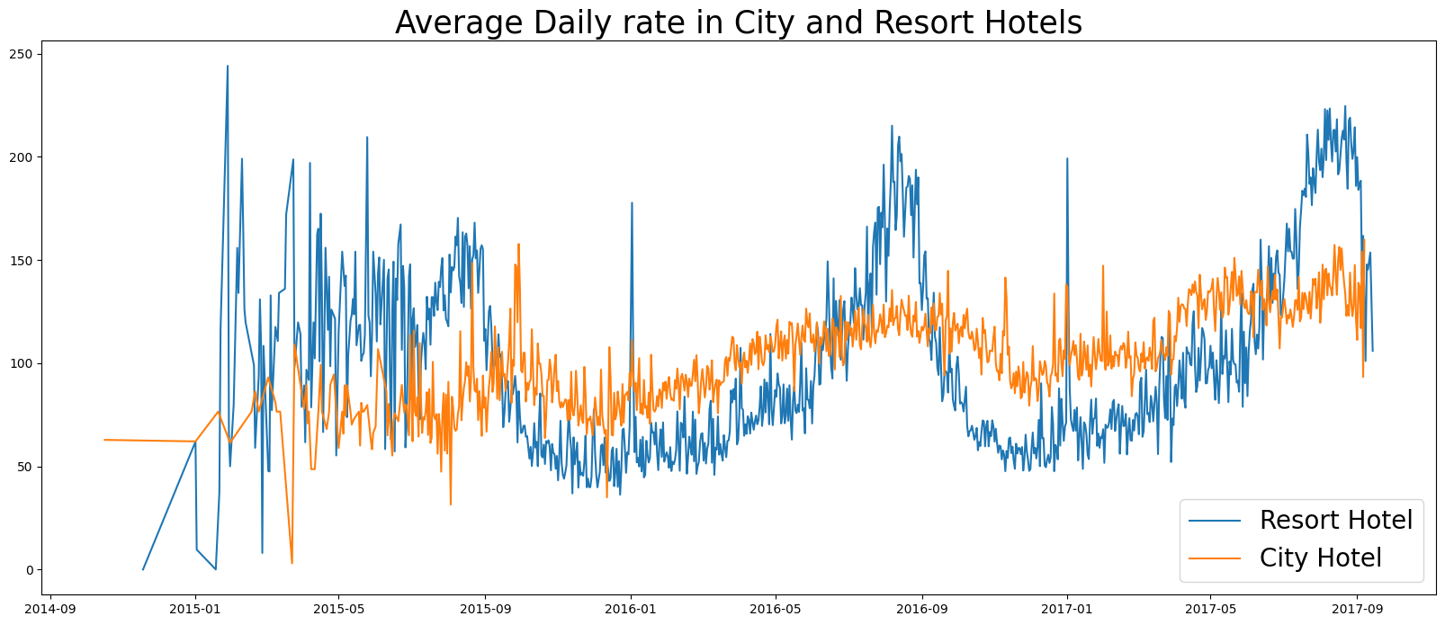
The line graph above shows that on certain days average daily rate (adr) for a city hotel is less in comparison to resort hotel and on other days it is even less. It goes without saying that weekends and holidays may see a rise in resort hotel rates.

Slide 7
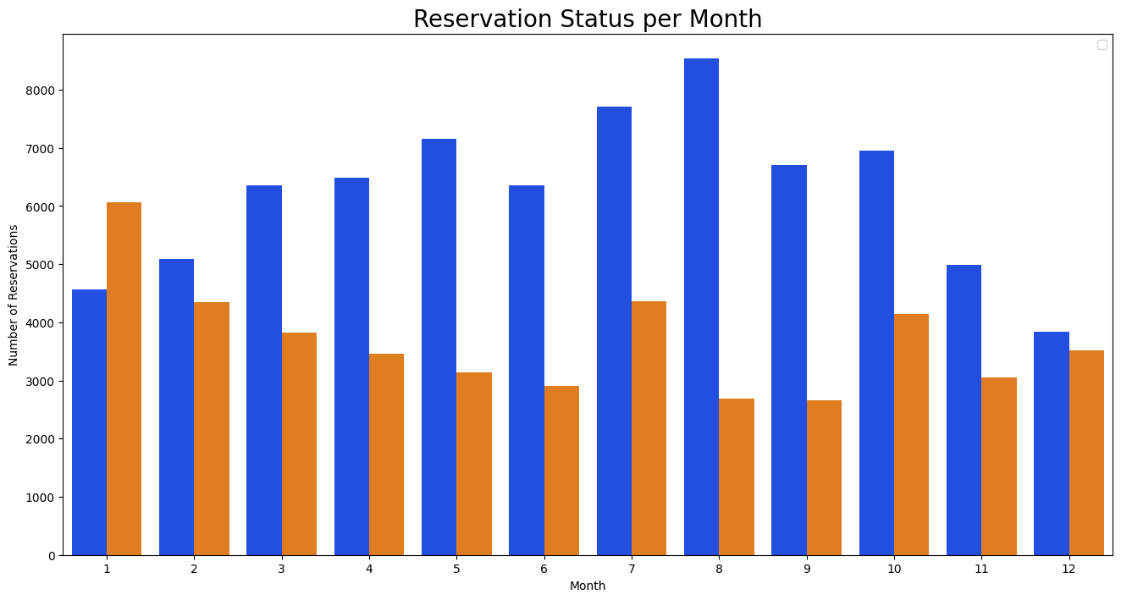
We have developed a group bar graph to analyze the months with the highest and lowest reservation levels according to reservation status. As can be seen both the number of confirmed reservation and the number of canceled reservations are largest in the month of August . Whereas January is the month with the most cancelled reservations.

Slide 8
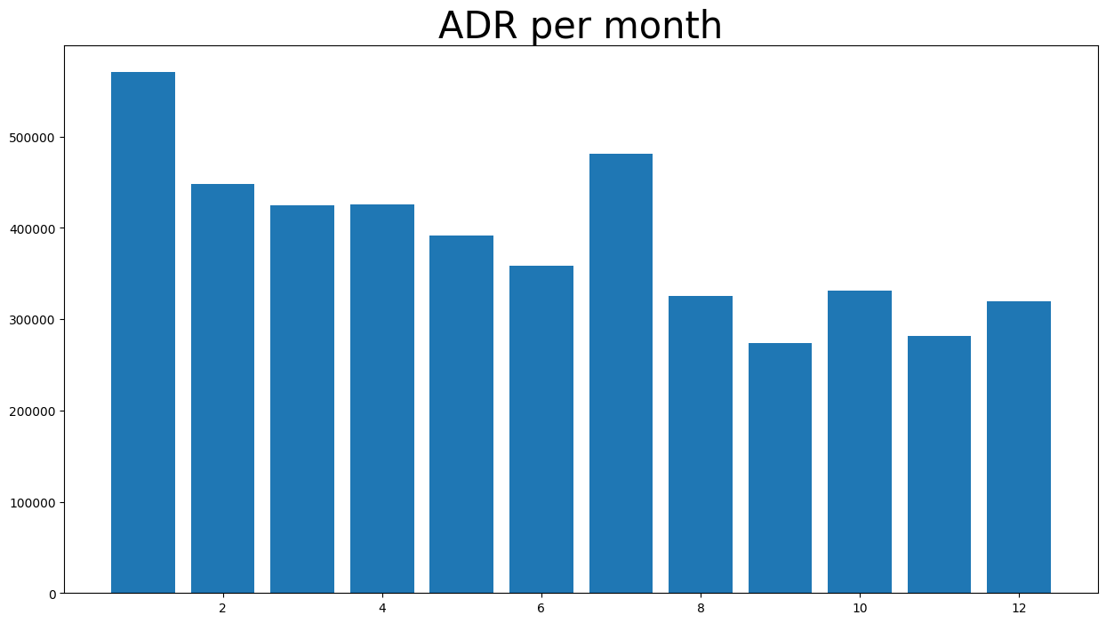
This bar graph demonstrate that cancellations are most common when prices are greatest and are least common when they lowest. Therefore ,the cost of accommodation is the solely responsible for the cancellation.

Slide 9
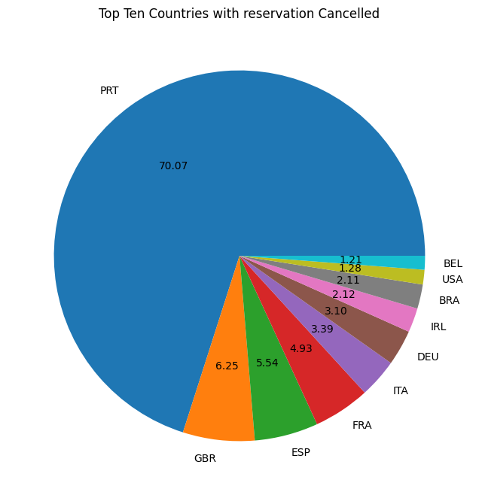
Now see which country has the highest reservation canceled .The top country is Portugal with the highest number percentage (70.07 %) of cancellations.

Slide 10
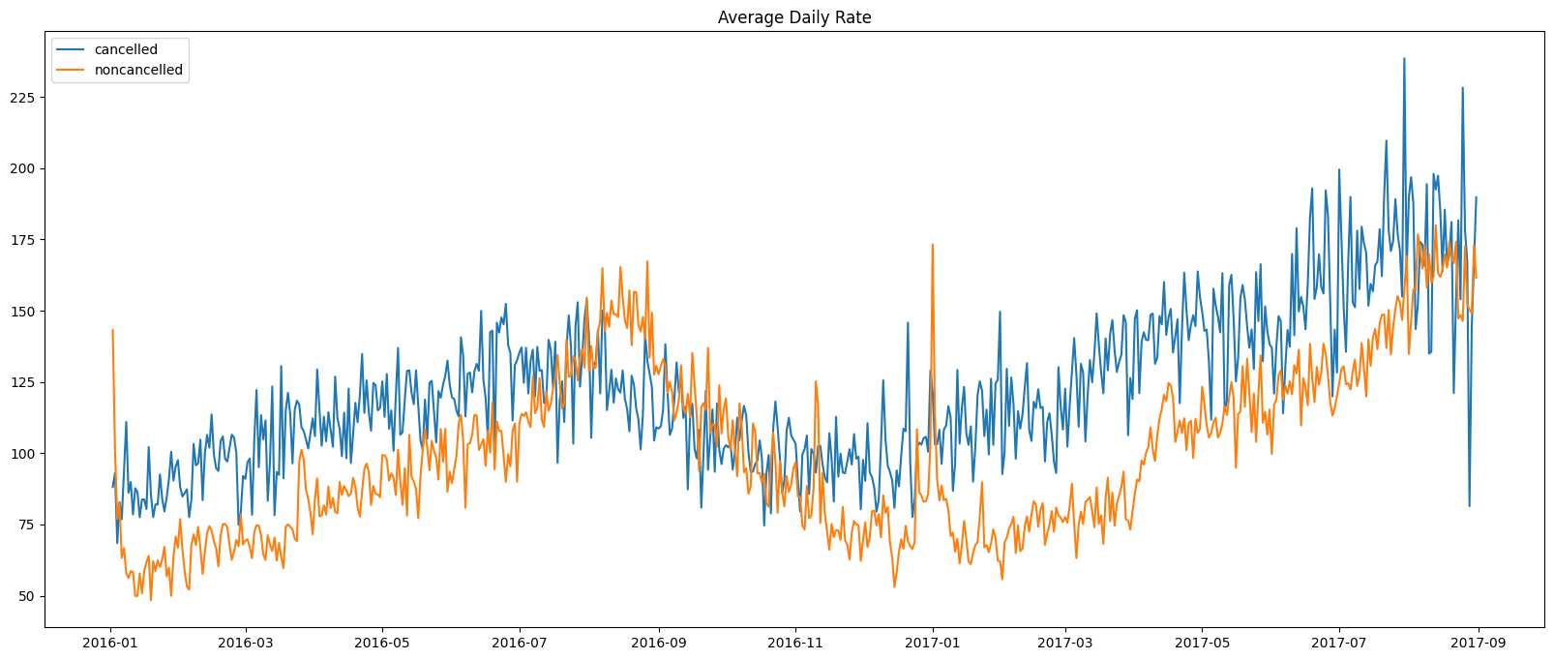
Lets check the area on cancelled reservations data from where guest are visiting the hotels and making reservations. It is coming from direct or groups, online offline travel agents? Around 46 % of clients comes from online travel agencies ,whereas 27 % comes from offline groups and only 4 % of clients book hotels directly by visiting them and make reservations.
As seen in this graph ,reservation are cancelled when the average daily rate is higher than when it is not cancelled . It is clearly prove all the analysis that higher price leads to higher cancellations.

Slide 11
Suggestions
Cancellation rates rise as the price does. In order to prevent the cancellations of reservations, hotel could work on their pricing strategies and trying to lower the rates for specific hotel based on their locations. They can also offer some discounts to the customers.
As the ratio of cancellation and not cancellation of the resort hotel is higher in the resort hotel than the city hotel.so the hotel should provides a reasonable discount on the room prices on weekends or other holidays.
In the month of January , hotels can start campaigns or marketing with a reasonable amount to increase their revenue as the cancellation is the highest in this month.
They can also increase the quality of their hotels and their services mainly in Portugal to reduce the cancellation rate.

